Slide 1
Suffix Trees
Lokesh Singh (2019201051)
Manish Chauhan (2019201052)

Slide 2
Trie
A tree representing a set of strings.
(Assume no string is a prefix of another)
Each edge is labeled by a letter.
No two edges outgoing from the
same node are labeled the same.
Each string corresponds to a leaf.
a
c
b
d
e
b
e
f
e
g
f
“aeef “
{ “aeef “ , “ad“ , “bbfe “ , “bbfg “ , “c “ }

Slide 3
Compressed Trie
Compress unary nodes, label edges by strings.
a
c
a
c
b
d
e
b
d
eef
bbf
e
f
e
g
e
g
f
{ “aeef “ , “ad“ , “bbfe “ , “bbfg “ , “c “ }

Slide 4
Suffix Tree
a
S = “x a b x a”
1 2 3 4 5
{
S₅= a
S₄= xa
S₃= bxa
S₂= abxa
S₁= xabxa
}
xa
5
4
bxa
bxa
bxa
3
2
1
The fourth suffix xa or the fifth suffix a won’t be represented by a leaf node.

Slide 5
Suffix Tree
S = “x a b x a $”
1 2 3 4 5 6
{
S₆= $
S₅= a$
S₄= xa$
S₃= bxa$
S₂= abxa$
S₁= xabxa$
}
a
$
xa
$
6
5
bxa$
$
bxa$
bxa$
4
3
2
1

Slide 6
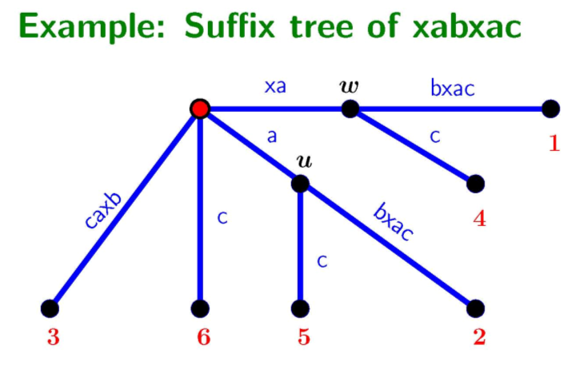
Suffix Tree

Slide 7
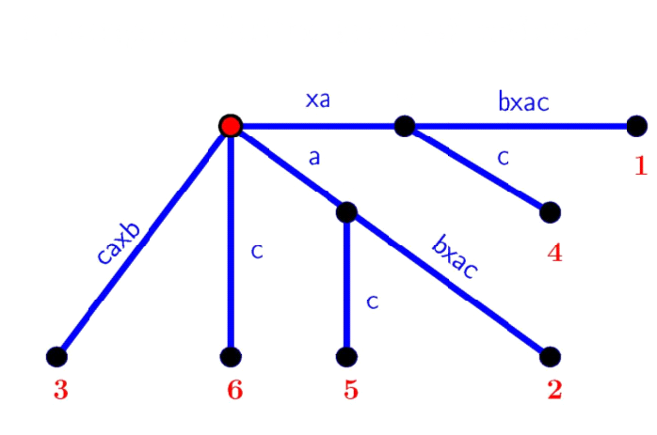
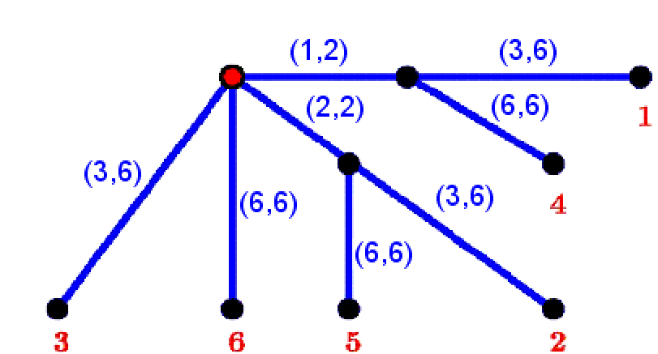
Suffix Tree Representation
S=xabxac
Represent every edge using its start and end text location

Slide 8
History of Linear Time Construction Algorithm
Weiner’s Algorithm
The algorithm of 1973 called by Knuth First Algorithm of linear time, but much space.
McGreight Algorithm
Linear Time and Quadratic Space
Ukkonen’s Algorithm
Linear time and less space

Slide 9
Ukkonen’s Algorithm
String S$ = S(1), S(2), …. S(m-1), S(m), $
S$ Prefixes:
Pref(1) = S(1)
Pref(2) = S(1)S(2)
. . .
Pref(i) = S(1)S(2)…S(i)
. . .
Pref(m-1) = S(1)S(2)….S(m-1)
Pref(m) = S(1)S(2)….S(m-1)S(m)
Pref(m+1) = S(1)S(2)….S(m-1)S(m)$ = S$
Ukkonen’s insertion order:
Suffixes(Pref(1))
Suffixes(Pref(2))
…
Suffixes(Pref(i))
…
Suffixes(Pref(m-1))
Suffixes(Pref(m))
Suffixes(Pref(m+1))

Slide 10
Extended Rule 1
Extending path S[j..i] to S[j..i+1]
Case 1: Path S[j..i] ends at a leaf.
- Extend the string on the last edge by one character S[i+1]
- Constant time

Slide 11
Extended Rule 2
Extending path S[j..i] to S[j..i+1]
Case 2: Path S[j..i] has extensions but none of them start with S[i+1]
- Create a new internal node if needed.
- Add a new edge to a new leaf j

Slide 12
Extended Rule 3
Extending path S[j..i] to S[j..i+1]
Case 3: Path S[j..i] has an extension that starts with S[i+1].
- Nothing need to be done, since we are working on the on the implicit suffix tree.
- Also constant time

Slide 13
Applications of suffix trees
Longest Common Substring
DNA Contamination Problem
Maximal Repetitive Structures
Longest common extension
Finding maximal palindromes
The k-mismatch problem

